Slide 1


Lecture 12-13: Basic Neural Nets Deep Feedforward Networks CS 109B, STAT 121B, AC 209B, CSE 109B
Mark Glickman and Pavlos Protopapas

Slide 2
Beyond Linear Models
Linear models
Can be fit efficiently (via convex optimization)
Limited model capacity
Alternative:
where is a non-linear transform

Slide 3
Traditional ML
Manually engineer
Domain specific, enormous human effort
Generic transform
Maps to a higher-dimensional space
Kernel methods: e.g. RBF kernels
Over fitting: does not generalize well to test set
Cannot encode enough prior information

Slide 4
Deep Learning
Directly learn
where are parameters of the transform
defines hidden layers
Non-convex optimization
Can encode prior beliefs, generalizes well

Slide 5
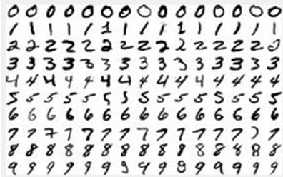
SVM vs Neural Networks
Hand-written digit recognition: MNIST data
See illustration in notebook

Slide 6
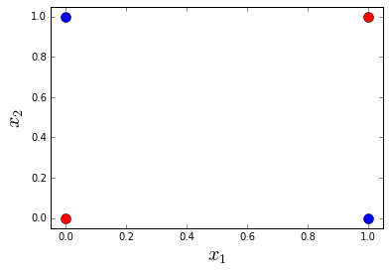
Example: Learning XOR
Optimal linear model (sq. loss)
Predicts 0.5 on all points

Slide 7
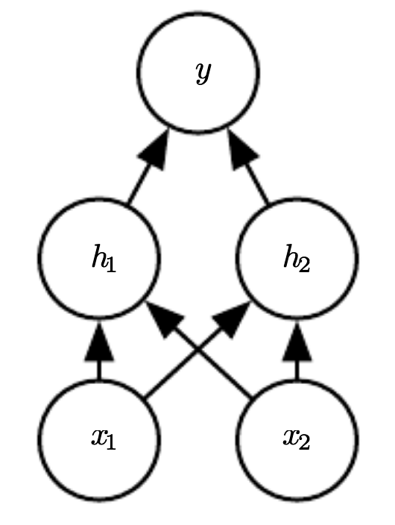
Example: Learning XOR
where,
See illustration in notebook

Slide 8
Design Choices
Cost function
Output units
Hidden units
Architecture
Optimizer

Slide 9
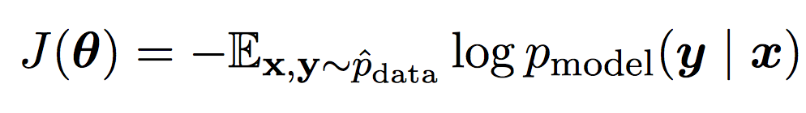
Cost Function
Cross-entropy between training data and model distribution (i.e. negative log-likelihood)
Do not need to design separate cost functions
Gradient of cost function must be large enough

Slide 10
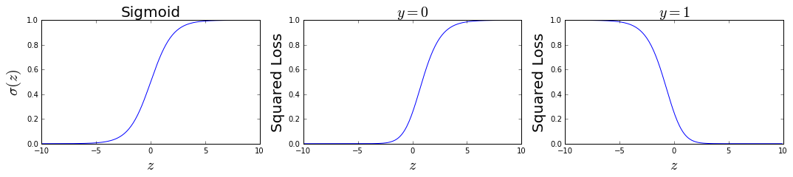
Cost Function
Example: sigmoid output + squared loss
Flat surfaces

Slide 11
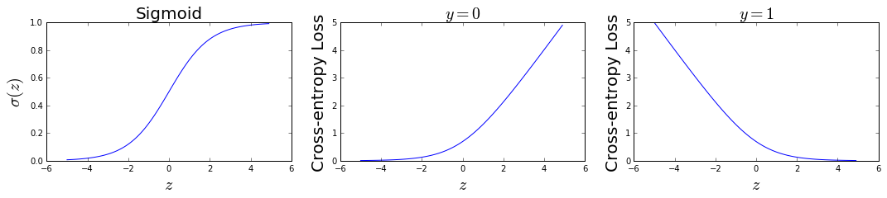
Cost Function
Example: sigmoid output + cross-entropy loss
log undoes exp
Saturates only when the model makes correct predictions

Slide 12
Design Choices
Cost function
Output units
Hidden units
Architecture
Optimizer

Slide 13
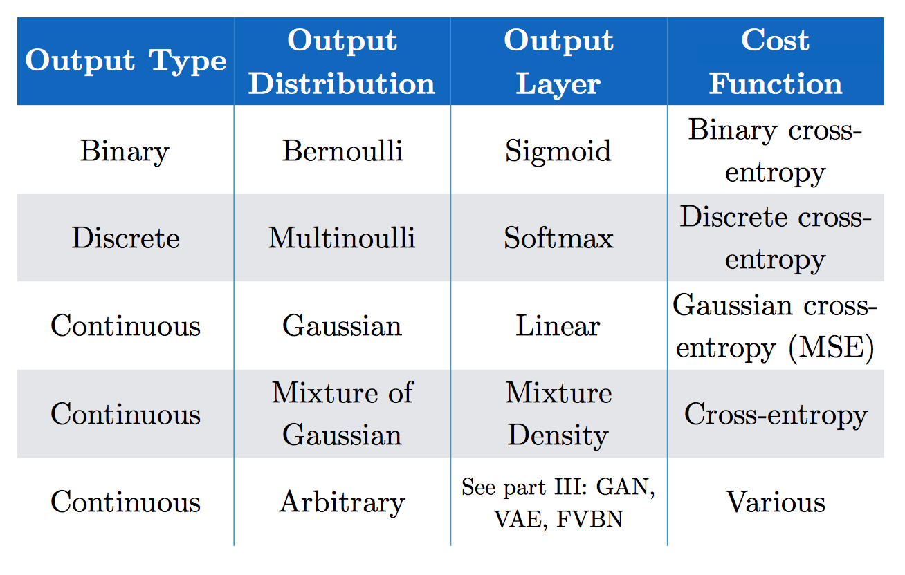
Output Units
(Goodfellow 2017)

Slide 14
Softmax Output
Discrete / Multinoulli output distribution
For output scores z₁, …, z_{n}
Log-likelihood undoes exp
(Score to target label – Maximum score)

Slide 15
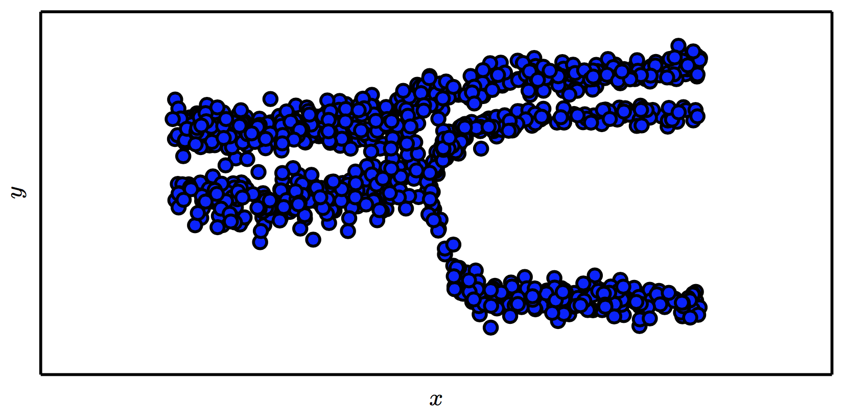
Mixture Density Output
(Goodfellow 2017)

Slide 16
Design Choices
Cost function
Output units
Hidden units
Architecture
Optimizer

Slide 17
Hidden Units
with activation function g
Ensure gradients remain large through hidden unit
Preferred: piece-wise linear activation
Avoid sigmoid/tanh activation
Do not provide useful gradient info when they saturate

Slide 18
ReLU
Rectified Linear Units
Gradient is 1 whenever unit is active
More useful for learning compared to sigmoid
No useful gradient information when z<0
0

Slide 19
Generalized ReLU
Generalization: For ,
E.g. Absolute value ReLU:
0

Slide 20
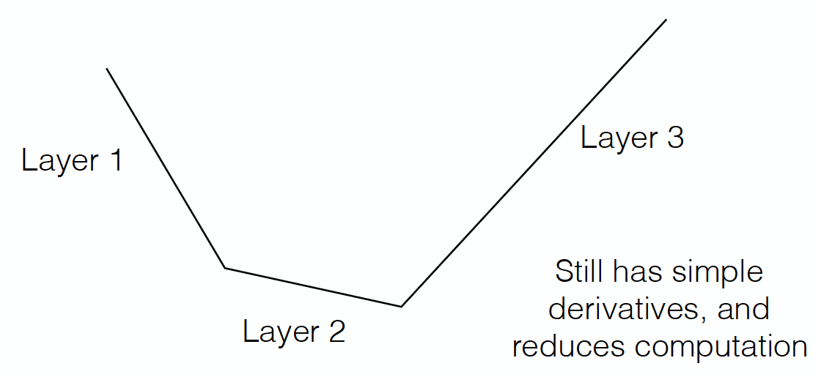
Maxout
Directly learn the activation function
Max of k linear functions
(α₁, β₁)
(α₃, β₃)
Line 3
(α₂, β₂)

Slide 21
Design Choices
Cost function
Output units
Hidden units
Architecture
Optimizer

Slide 22
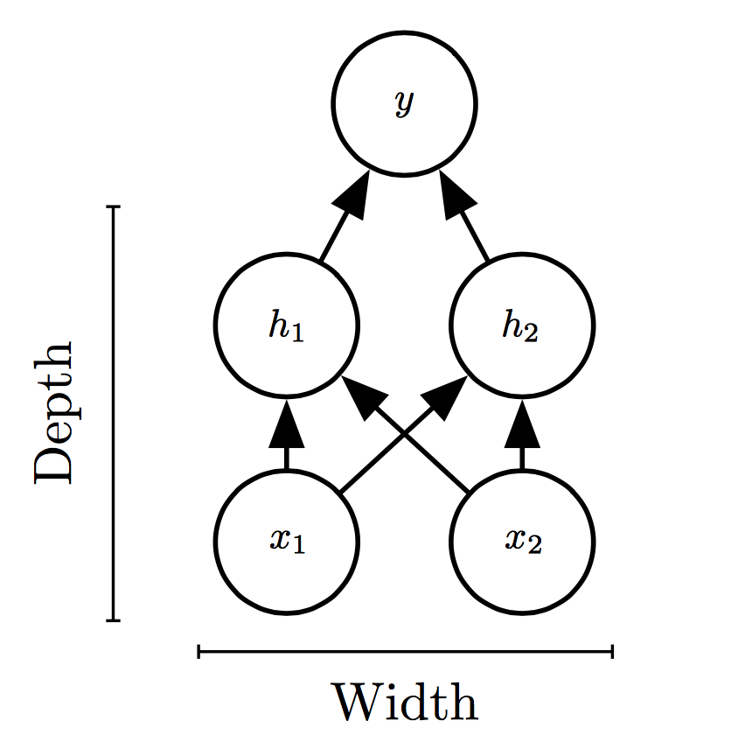
Universal Approximation Theorem
One hidden layer is enough to represent an approximation of any function to an arbitrary degree of accuracy
So why deeper?
Shallow net may need (exponentially) more width
Shallow net may overfit more

Slide 23
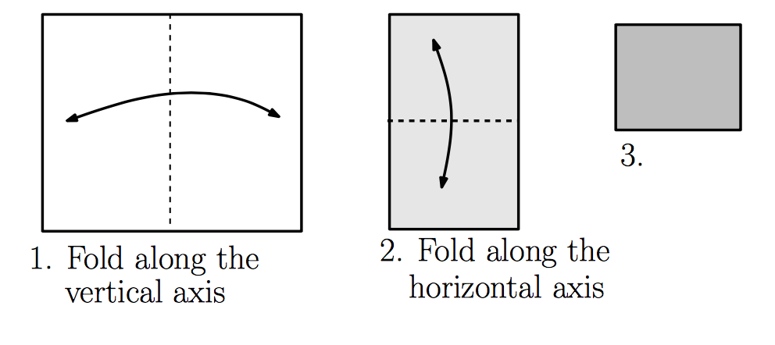
Exponential Gain with Depth
Each hidden layer folds the space of activations of the previous layer. E.g. abs activation
Montúfar (2014)

Slide 24
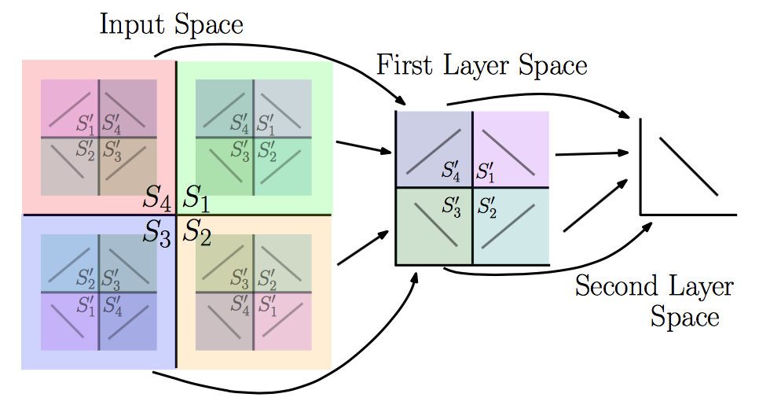
Exponential Gain with Depth
With N hidden layers, there are O(4^{N}) piecewise linear regions
Montúfar (2014)
See illustration in notebook

Slide 25
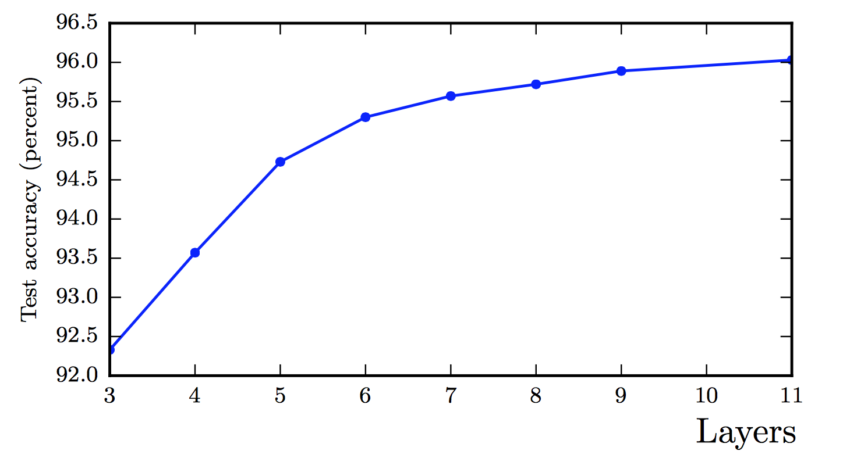
Better Generalization with Depth
(Goodfellow 2017)

Slide 26
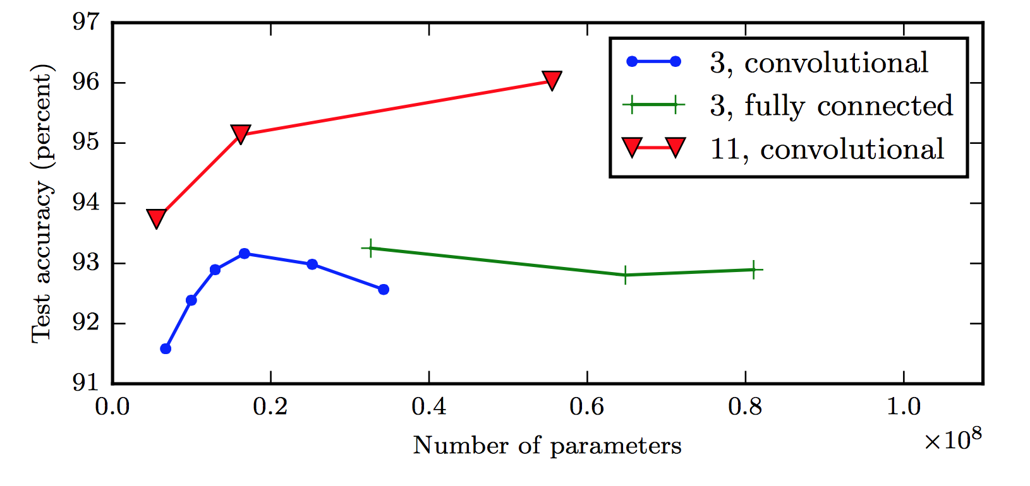
Large, Shallow Nets Overfit More
(Goodfellow 2017)

Slide 27
Design Choices
Cost function
Output units
Hidden units
Architecture
Optimizer

Slide 28
Gradient-based Optimizer (e.g. stochastic gradient descent)
“Chain rule” for computing gradients:
For deeper networks
Naïve computation takes exponential time

Slide 29
Backpropagation
Avoids repeated sub-expressions
Uses dynamic programming (table filling)
Trades-off memory for speed

Slide 30
Backprop: Arithmetic
Jacobian-gradient products
grad w.r.t. x
Jacobian of ‘g’
grad w.r.t. z
Apply recursively!

Slide 31
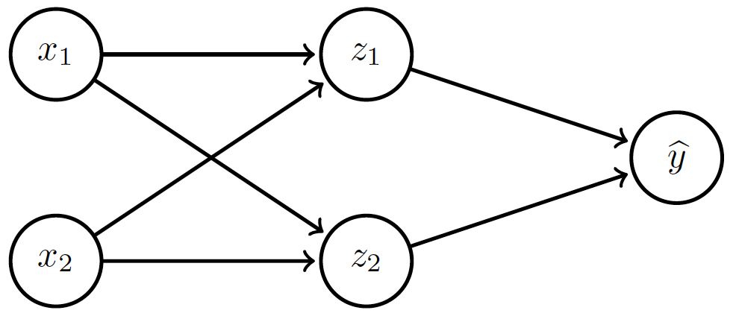
Backprop: Overview
Forward prop: compute activations
Compute loss
Back-prop: compute derivatives

Slide 32
Backprop: Example
Linear activation functions
No bias
Squared loss

Slide 33
Backprop: Example
Forward prop: Propagate activations to output layer

Slide 34
Backprop: Example
Backward prop: Compute loss and its derivative

Slide 35
Backprop: Example
Backward prop: Compute derivatives w.r.t. weights c₁ and c₂

Slide 36
Backprop: Example
Backward prop: Compute derivatives w.r.t. weights c₁ and c₂

Slide 37
Backprop: Example
Backward prop: Propagate derivative to hidden layer

Slide 38
Backprop: Example
Backward prop: Compute derivatives w.r.t. weights a₁, a₂, b₁ and b₂

Slide 39
Backprop: Example
Backward prop: Compute derivatives w.r.t. weights a₁, a₂, b₁ and b₂

Slide 40
Backprop: Example

Slide 41
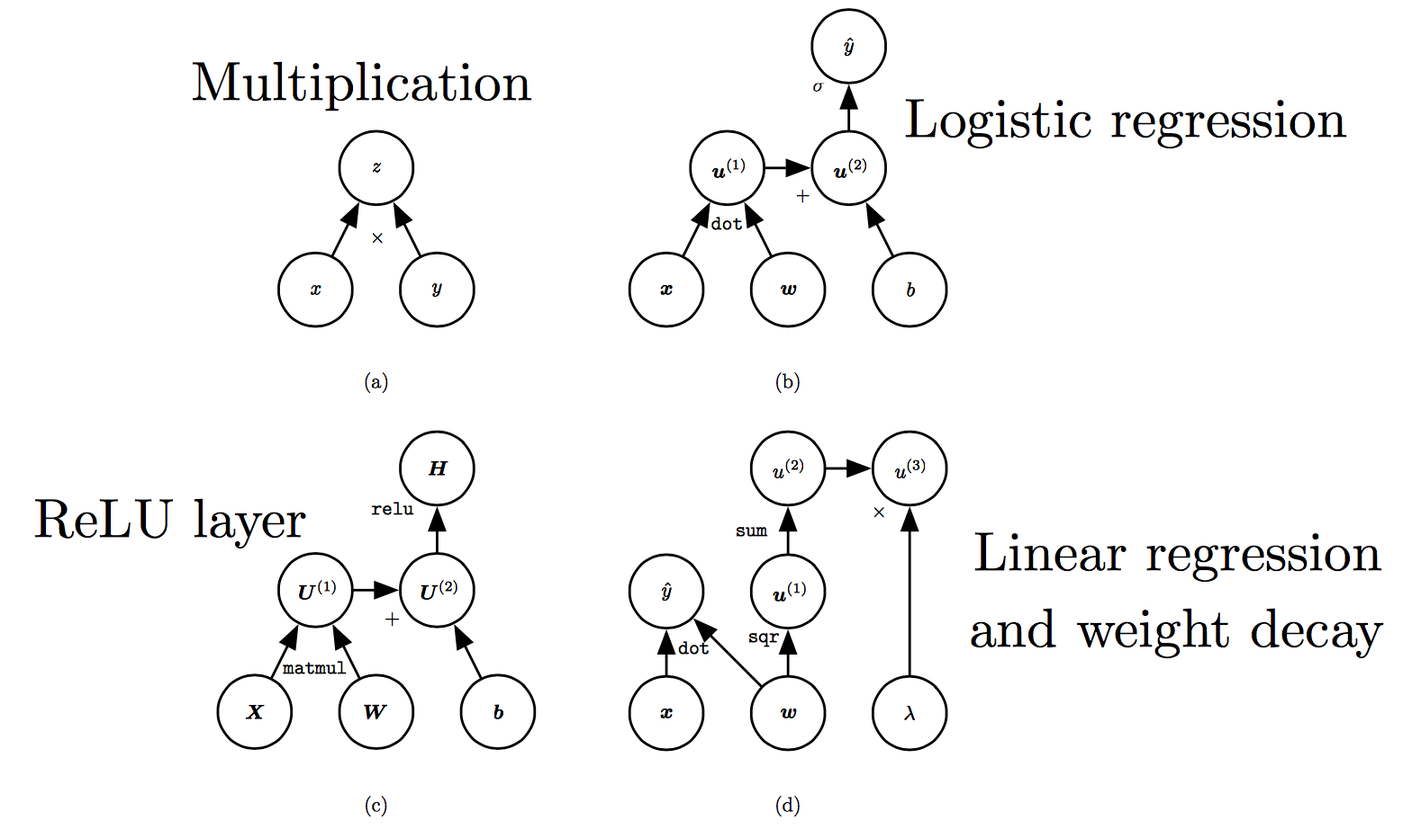
Computation Graphs
(Goodfellow 2017)

Slide 42
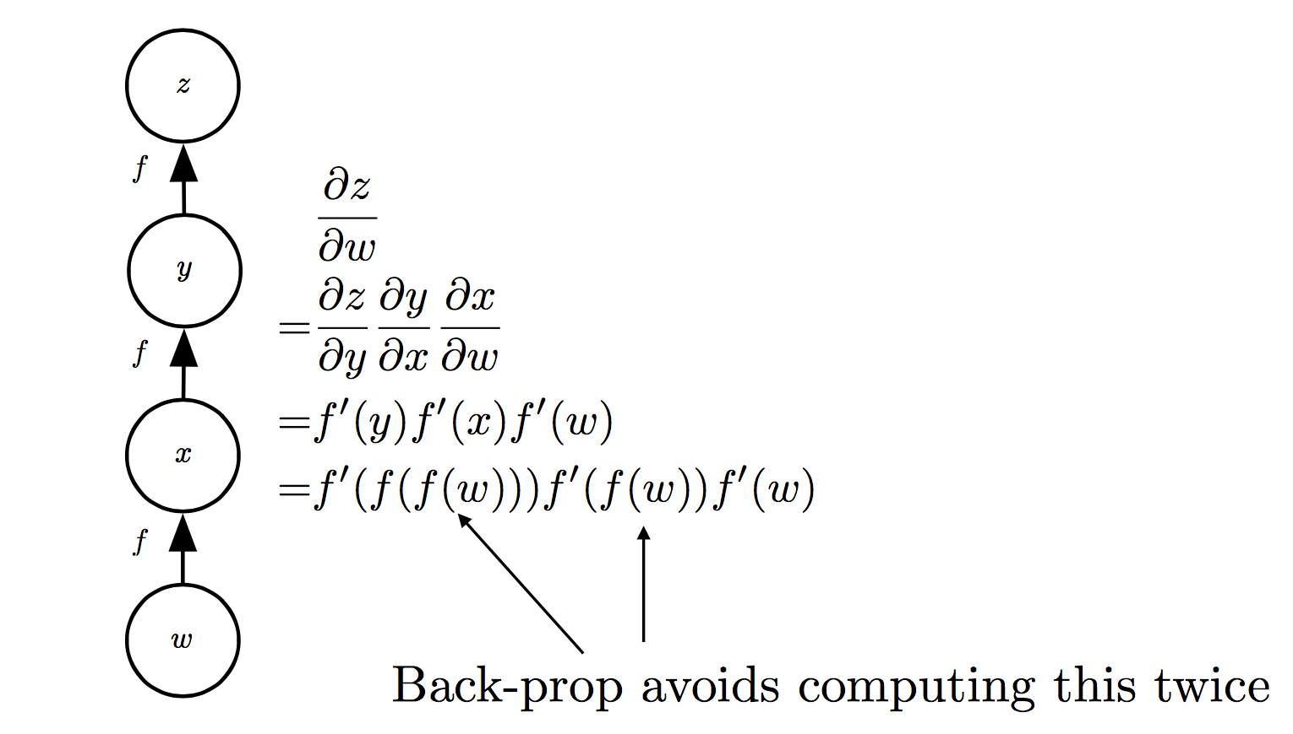
Repeated Sub-expressions
(Goodfellow 2017)

Slide 43
Backprop on Computation Graph
Maintain grad table
Parents of u^{i}

Slide 44
Symbol-to-symbol Differentiation
Derivatives as computation graphs
Same language for both forward and back-propagation
During execution, replace symbolic inputs with numeric value
Used by Theano and TensorFlow
Symbol-to-number differentiation: e.g. Torch and Caffe

Slide 45
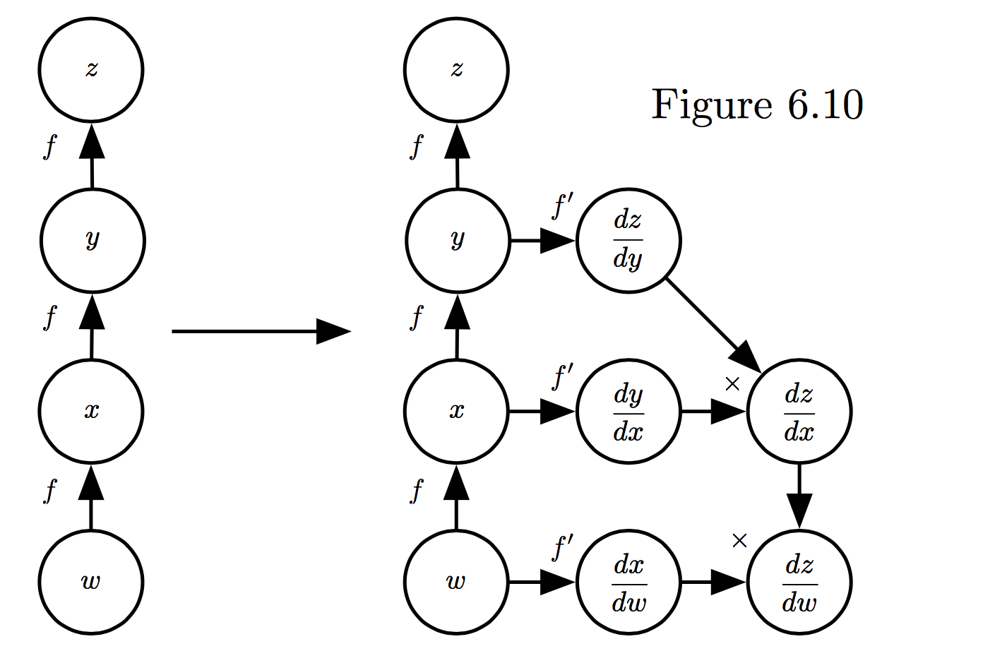
Symbol-to-symbol Differentiation
(Goodfellow et al. 2017)

Slide 46
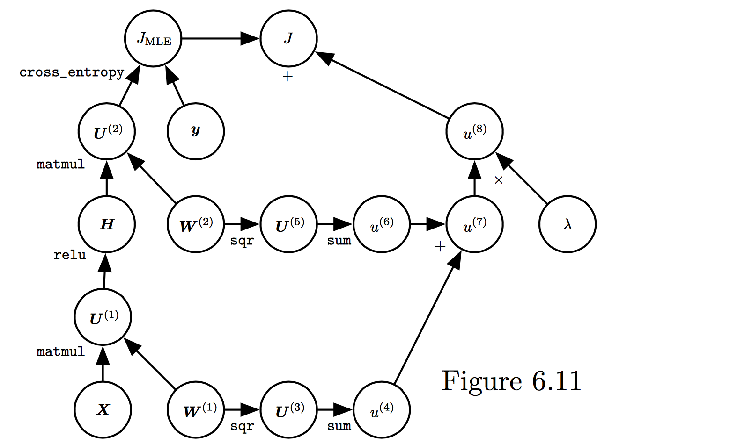
Training Feed-forward Nets
Computational cost for forward/back prop: O(#num-weights)
Memory cost:
O(#num-layers x minibatch-size)
(Goodfellow et al. 2017)

